Slide 1


Summary of Steering Committee Meeting
Planning for PRAGMA’s Future
PRAGMA 19
13 – 15 September 2010

Slide 2
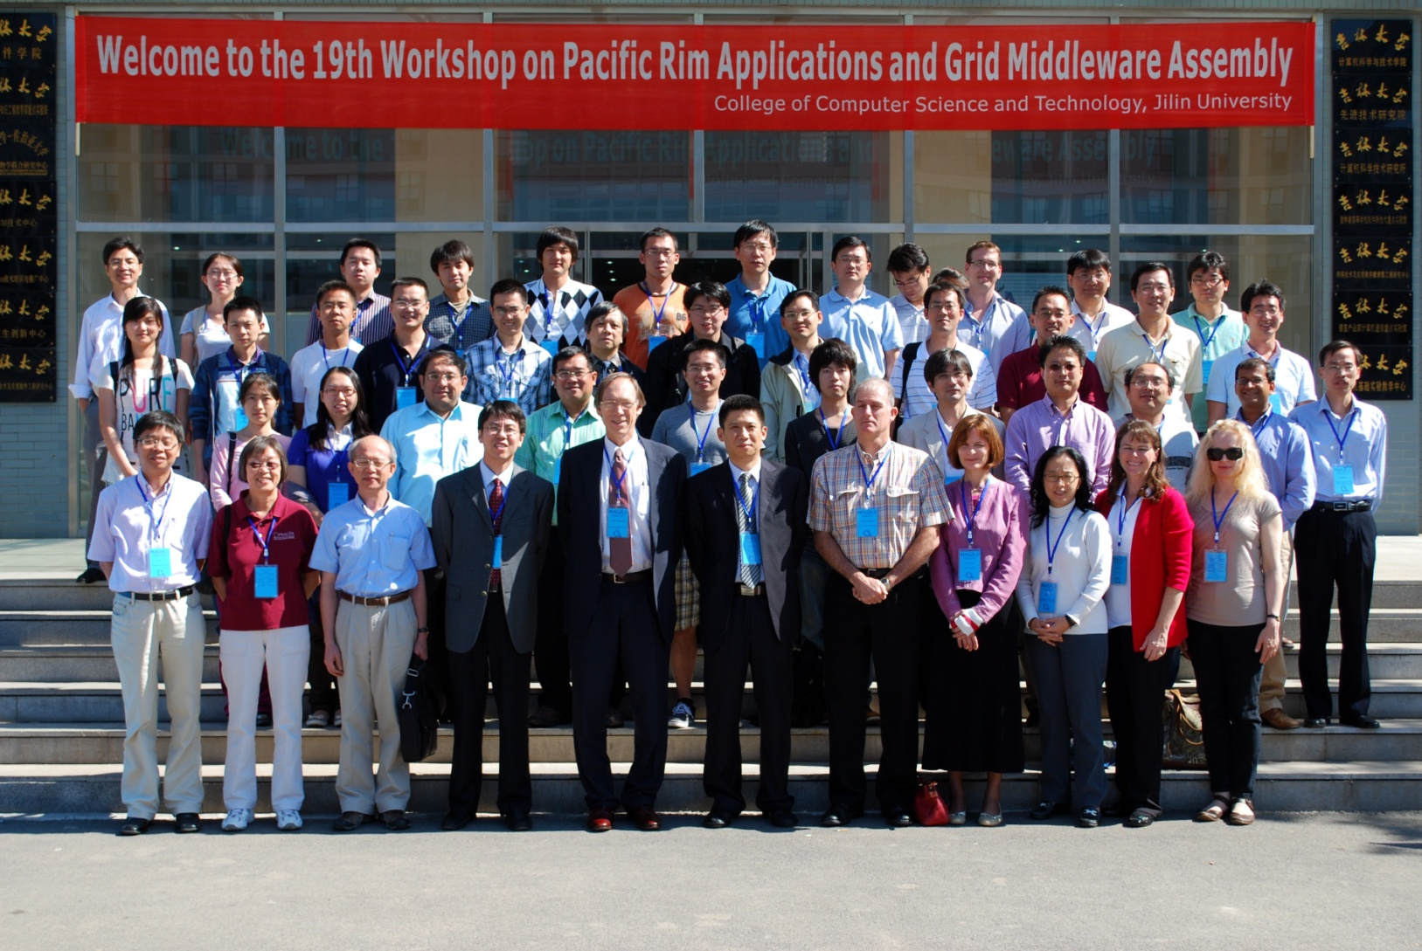

Slide 3
Topics
Strategic Planning
Future Workshops
Data Sharing
Dissemination

Slide 4
Strategic Planning: Successes “We are still actively working together”
Exchange:
Ideas: learning quickly the trends in other institutions
Products: testing and adopting improves codes
People: creating global engineers and developing tools
Leads to trust!
Growth:
Members: bringing in new ideas, interests, expertise
Project: helping colleagues winning projects
Careers: assisting individuals develop careers and grow professionally.
Framework and Model:
Spin-off: GLEON, CREON
Create: PRIME, PRIUS, MURPA

Slide 5
Strategic Planning: Challenges
Funding: Need time and resources to collaborate
Diversity: Balance focus with openness
Common Goal: An aim for all participants
But some issues
Products: Tools, services, knowledge for others
Stay young: Agile, new ideas and peoples

Slide 6


Future Workshops
PRAGMA 20: 2 – 4 March 2011, Hong Kong
University of Hong Kong
2 March 2011: Tutorials in Geosciences
3 and 4 March 2011: PRAGMA 20
PRAGMA 21:
Discussed proposal by AIST to host workshop in Sapporo Japan
Late September/October 2011

Slide 7
Data Sharing
GEOGrid can provide data from AIST and NSPO/NARL
NSPO wants to share data with PRAGMA
Clarify acknowledgement and use of data

Slide 8
Dissemination
Brochure
Historical record of accomplishments
Slimmer design
New Feature: How as involvement of PRAGMA benefited your institution
SC10
Will be there, no NBCR booth this year

Slide 9
Thank you!

